Slide 1

Session 3
AI = Intelligent computer programs that can perceive, reason, learn, and act in complex environments (Russell & Norvig, 2022)

Slide 2
Agenda
In this session, we will discuss:
Introduction to AI Agents
The ReAct paradigm for Agentic Systems
Implementing a ReAct Workflow to Query Tabular Data
Function Calling

Slide 3
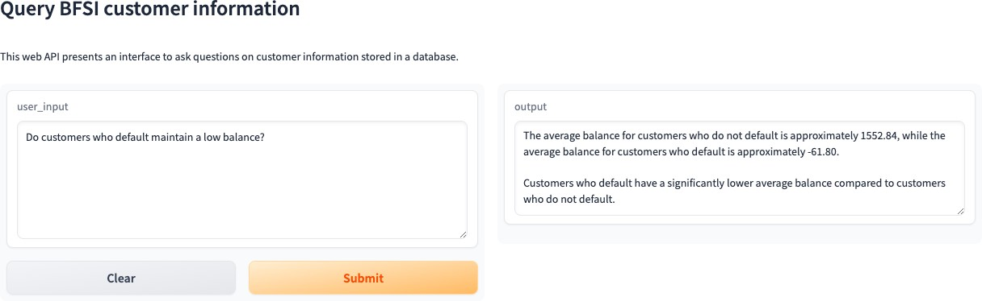
Demo

Slide 4
Introduction to Agents

Slide 5

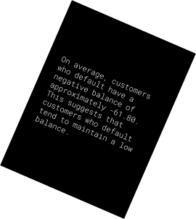

A Framework for AI Agents
Memory
Guardrail
Objective
World Model
Task Objective
Perception
Initial world representation
Predicted action sequence
Input
Action Sequence
(LeCun, 2022)
On average, customers who default have a negative balance of approximately -61.80. This suggests that customers who default tend to maintain a low balance.
Do customers who default maintain a low balance?

Slide 6

Defining Agents
Plan
Identify specific tables in the database that relate to the input
Compose a SQL query to achieve the objective Run the query in a dedicated thread and collect the
output
Present the output in natural language
Agent
LLM
Tools
Search Engine, Python Runtime, Database…
User Input
How many customers have
subscribed to the term deposit?
Objective
Execute
GPT
Database
GPT
Compose Query
Execute Query
Summarize Output

Slide 7
ReAct Paradigm for Agents

Slide 8
Agents use the ReAct Paradigm
Agent
Scratchpad
LLM
Thought 1
Thought 2
Thought N
Action
Space
Action 1
Action 2
…
Action N
Observation
Observation 1
Observation 2
Observation N
Final Solution

Slide 9

Database Agent Workflow
How many customers subscribed to the term deposit?
Agent
5,289 users subscribed to a term deposit.
action: I should query the database to count number of users with subscribed_status = ‘Yes’
Action_input: <SQL Query>
Database
Agent
Tool

Slide 10
Implementing an Agentic Workflow
User Input
Final Answer
True
AgentFinish
Agent
False
Memory
Retry
Thought
Action Observation

Slide 11
Agents Hands-on
Building a Python Agent
Building a Search Agent
Building a Data Frame Agent

Slide 12
Building Agents with Function Calling
Plan
Identify which function should be called to achieve the objective
Compose the appropriate input to the function Run the function in a dedicated thread and collect
the output
Present the output in natural language
Agent
LLM
Functions
News Search, Price Enquiry
User Input
What is the latest stock price
for MSFT?
Objective
Execute
GPT
Function
GPT
Compose Function Call
Execute Query
Summarize Output

Slide 13
Function Calling Hands-on
- Building a Financial Information Agent

Slide 14
Summary
Actions
Predefined set of tools
that plan and execute
Tool Aware
LLMs
Agents
are
that
formulate
input to
Functions
Focused instructions

